Slide 1
Web Servers and Web Apps
Including Frameworks

Slide 2
Frameworks
A Framework contains an "almost" complete app code, including logic for the flow of control.
You must supply
configuration data (text file, XML, Json, ...)
missing methods the framework will invoke, "slots"
application logic
domain model ("model") for persistent objects
and optionally
override frameworks methods with custom code
add callbacks, "hooks", for extra functionality

Slide 3
Framework versus Library
An application framework "runs" the application.
the framework calls your code
"don't call us, we'll call you"
Library - provides functions you call, classes you use
Requests is a library of functions for sending HTTP requests
numpy is a library for numerical computing
Your app calls numpy code, it returns a result

Slide 4

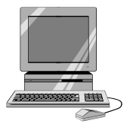
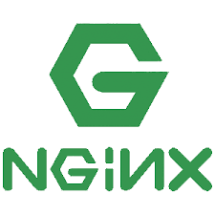
Handling a web request
(1) A web client submits a web request:
https://superstore.com/products/list
an https packet is sent to the superstore.com server...
GET /products/list
(2) A host (server) receives tcp packet and looks for app listening on port 443.
(3) Give packet body to listening web server.
listen *:443

Slide 5
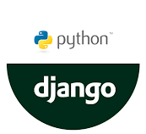
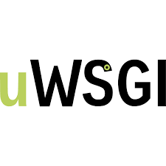
Http Server hands off to web app
(4) The web server examines the request path and determines it should give it to the web application.
The web server may do some pre-processing first.
WSGI adapter

Slide 6
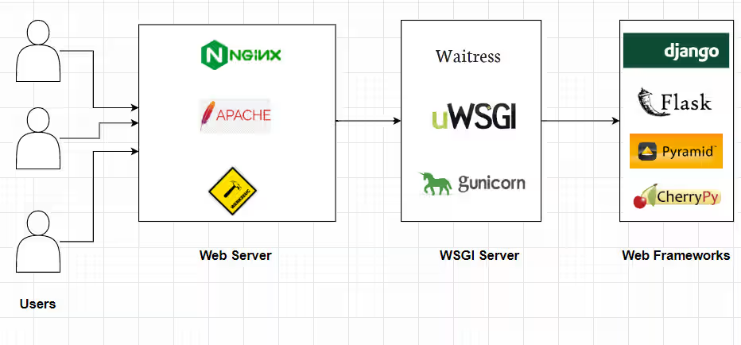
Web Server Gateway Interface
WSGI defines a standard way for web servers to communicate with web application written in Python.
A WSGI implementation (like uWSGI) is an adapter or container.
It translates HTTP requests into a standard format & invokes code via a standard API.
WSGI Adapter
Python app using framework

Slide 7
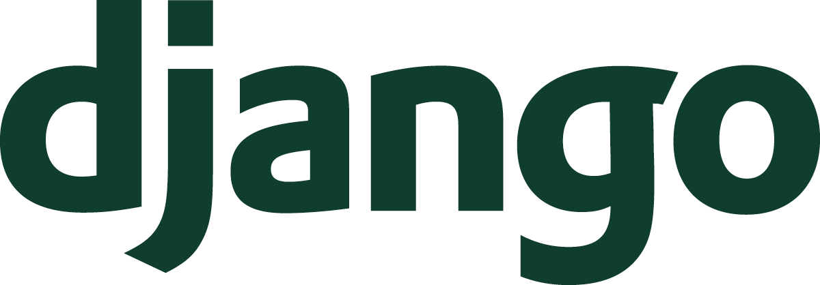
Decide which code should handle it
(5) web app framework parses the HTTP request and creates a HttpRequest object containing request path, headers, session info, query params, and request body.
(6) django framework compares the request path /products/list/ to a "routing" or "url mapping" table specified by the app.
(2) The server computer forwards it to a web server running on port 8080.
HttpRequest
object
urls.py
path --> code
pattern --> code2
urlpatterns = [
path('products/list/', prod_list),
... ]
framework

Slide 8
Your "controller" handles the request
(7) Django framework invokes your code (prod_list) with the HttpRequest object as parameter...
(8) your code must handle the request and return an HttpResponse object.
(2) The server computer forwards it to a web server running on port 8080.
HttpRequest
object
prod_list(request)
HttpResponse
framework

Slide 9
What your "controller" does
(8) Your controller (Django: "view") applies application logic and uses the Django code to handle the request.
For a product list, it uses the Product model class to get the products from a database (the Django framework does this).
Then, use a template (your code) to create a web page containing products. This is called rendering.
(2) The server computer forwards it to a web server running on port 8080.
all()
prod_list(http_request)
<<model>>
Product
prodList
render template
<<template>>
product_list.html

Slide 10
Web App Vocabulary
What | Typical Web Framework | Django
Mapping of request path to code | routing based on url | routing, uses urls.py
Code that handles requests | controller | view
Class that represents something in the app domain | model | model
Code or template to generate a web page | view | template
Process a template with data to create a web page | rendering | rendering

Slide 11
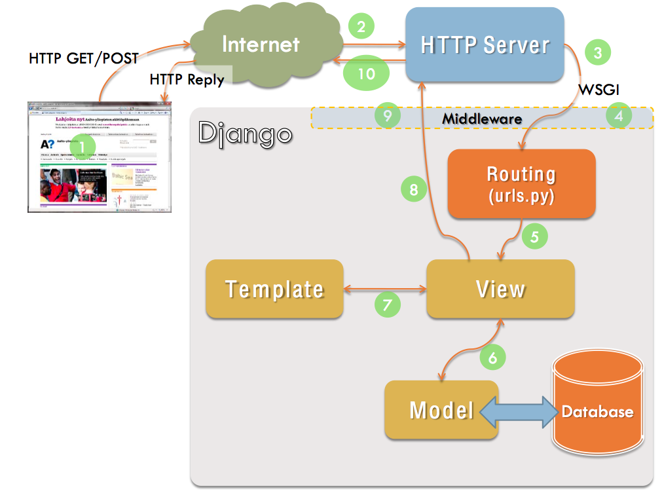
Summary
Source:
https://devopedia.org/django

Slide 12
Resources

